Slide 1
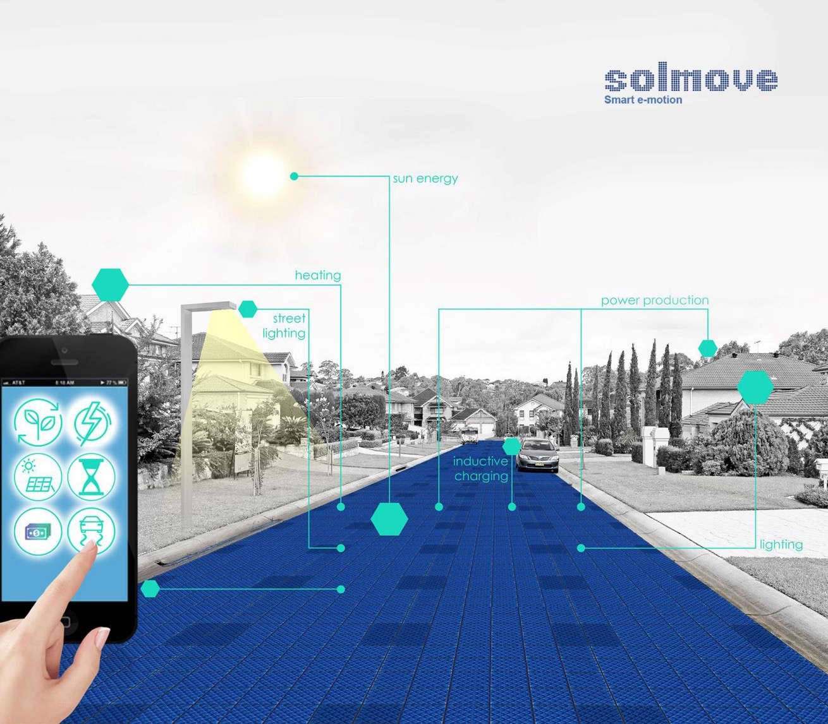

Enabling Smart Solar Streets (S³)
www.solmove.com
Notes:
SOLMOVE's core product is an innovative multi functional surface for streets and other sealed areas.
The modular system produces green electricity, heat to de-ice the surface, light for more safety and inductive charging for electric cars.
Benefits are preserving the land available for agricultural use, added value for existing assets and enable each community to contribute locally to the energy transition.
SOLMOVE is certified for supporting the UN Sustainable Development Goals; No. 7: Clean energy; 9: Industry, innovation and infrastructure, 11: Sustainable cities and communities.

Slide 2
CHALLENGES AHEAD
CHALLENGE
Increasing energy demand
Inefficient land use for renewable energies
Lack of acceptance for current approaches
No car2X support from streets
Road conditions
  Expensive winter service
  Inflexible and insufficient lighting
  Traffic jams
  Static traffic control
Sources: IEA 2019 ; IRENA 2017 ;
Notes:
2
Solar and wind power use large natural areas
EVs need clean electricity & charging infrastructure
Communities need income to finance road construction

Slide 3



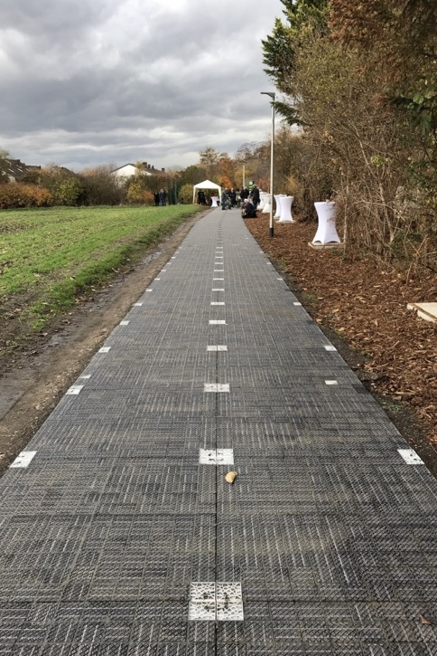
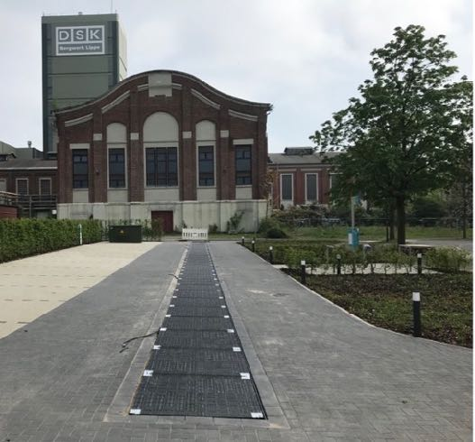
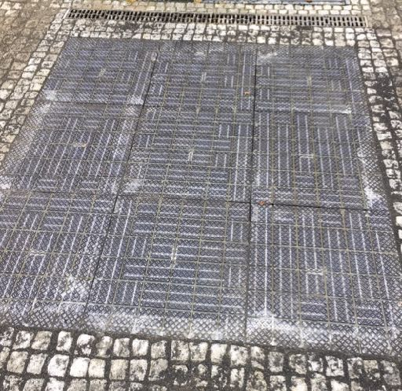
SOLUTION
solmove is transforming ordinary roads into smart solar streets, helping cities and municipalities getting smarter and more sustainable, every day - by foot, bike or car!
Bikelane in the City of Erftstadt
74 TEUR hardware sale
Parking area Torhäuser at Gelsenkirchen
70 TEUR hardware sale
Entrance area at RheinEnergie Training centre
12 TEUR hardware sale
40 sqm / 28 modules

Slide 4
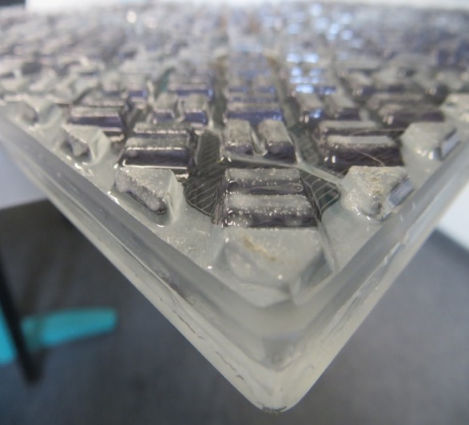
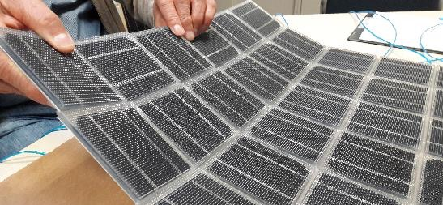
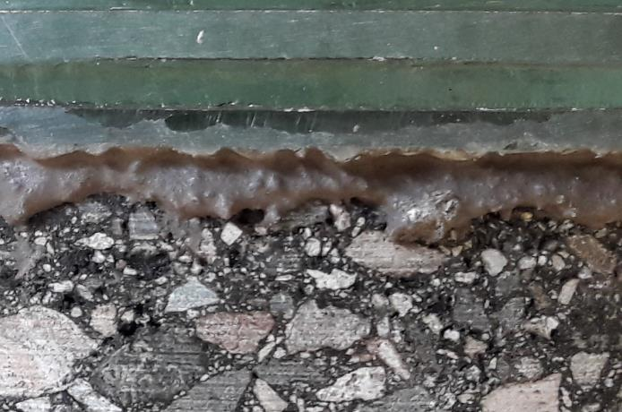





PRODUCT
CHALLENGE
Agile development to implement learnings from prototyping
Outstanding characteristics:
Solar power production with high-efficiency monocrystalline solar cells
Background area lighting with RGBW-LEDs
Surface heating for de-icing
Bonding on asphalt or concrete surfaces
Data collecting e.g. power, temperature, pressure, vehicle identification
Meshed wireless communication network
Plug-in module interconnection
“Open system” for other stakeholders
solmove module
Adhesive
Asphalt
Notes:
4

Slide 5
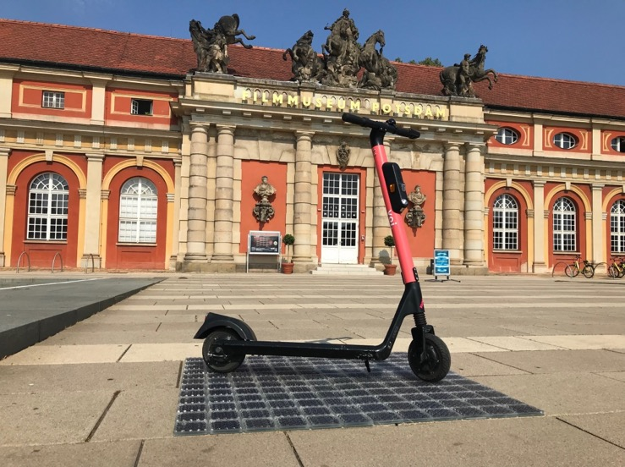


IDEAS for market entry
e Scooter Charging
green energy, green image
inductive charging reduces costs
off grid power makes independent
neutral platform increase acceptance
Pilotprojekt (in Vorbereitung)
Partner
Metz Moover
Würth Elektronik
Solarfläche:
1,2m x 4,2m (14 Module)
Liefern 600Wh bei Sonne

Slide 6
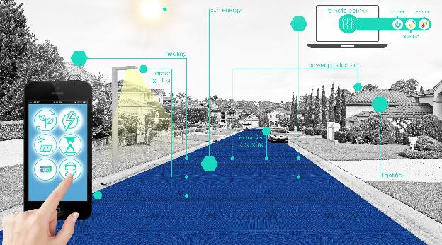
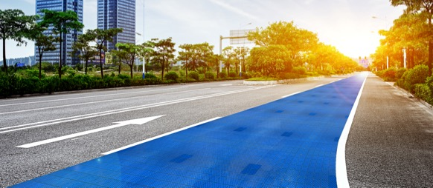
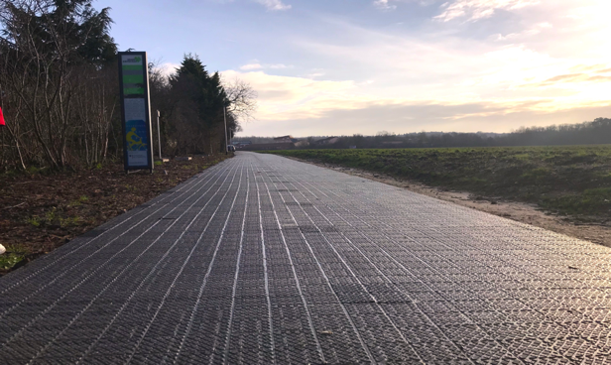
WAY & VISION
2024
+ Software & sensors
Data based services: e.g. Toll control
Parking, Billing & Payment
Ecosystem / S³ platform
2022
+ Hardware extension
Lighting, Heating
Inductive charging, Monitoring
Smart Street
2018
Proof of Concept

Slide 7

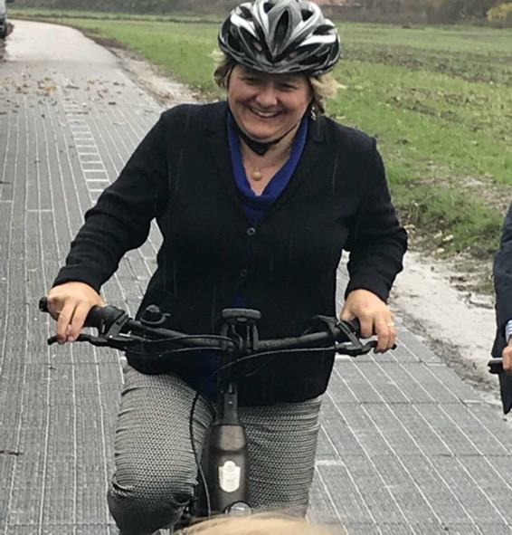
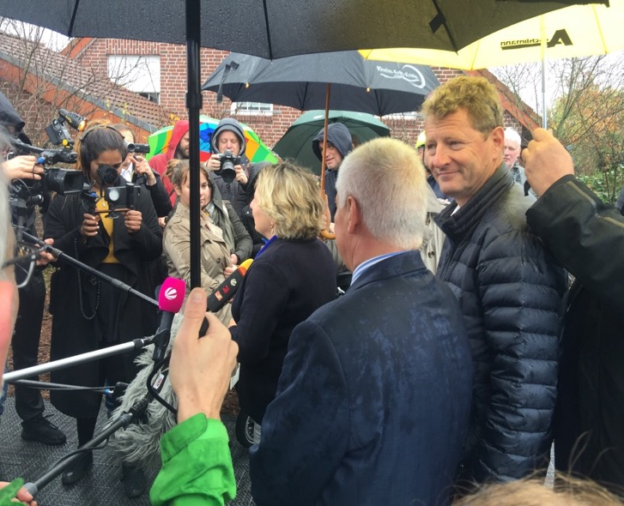







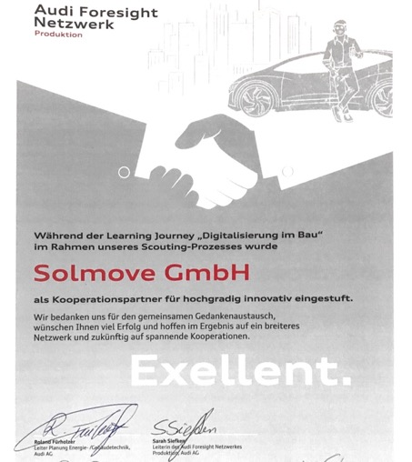




AWARDS
WINNER 2016
(category “Energy”)
WINNER 2016
WINNER 2017
(German pre-selection)
WINNER 2018
Windnode Challenge
China German
Innovation Award
WINNER 2019
WINNER 2018
WINNER 2018
WINNER 2018
WINNER 2018
Erftstadt / Köln, Nov 12th, 2018: Opening of the 1st Solar Bike Lane
by Federal Minister for the Environment Svenja Schulze
Startupnight DUBAI
Second price 2020

Slide 8















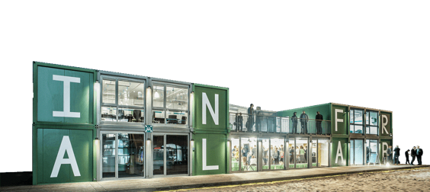




PARTNERS
Research
Development
Distribution
Finance
Solmove is part of several innovation hubs, research cooperations and governmental grants

Slide 9
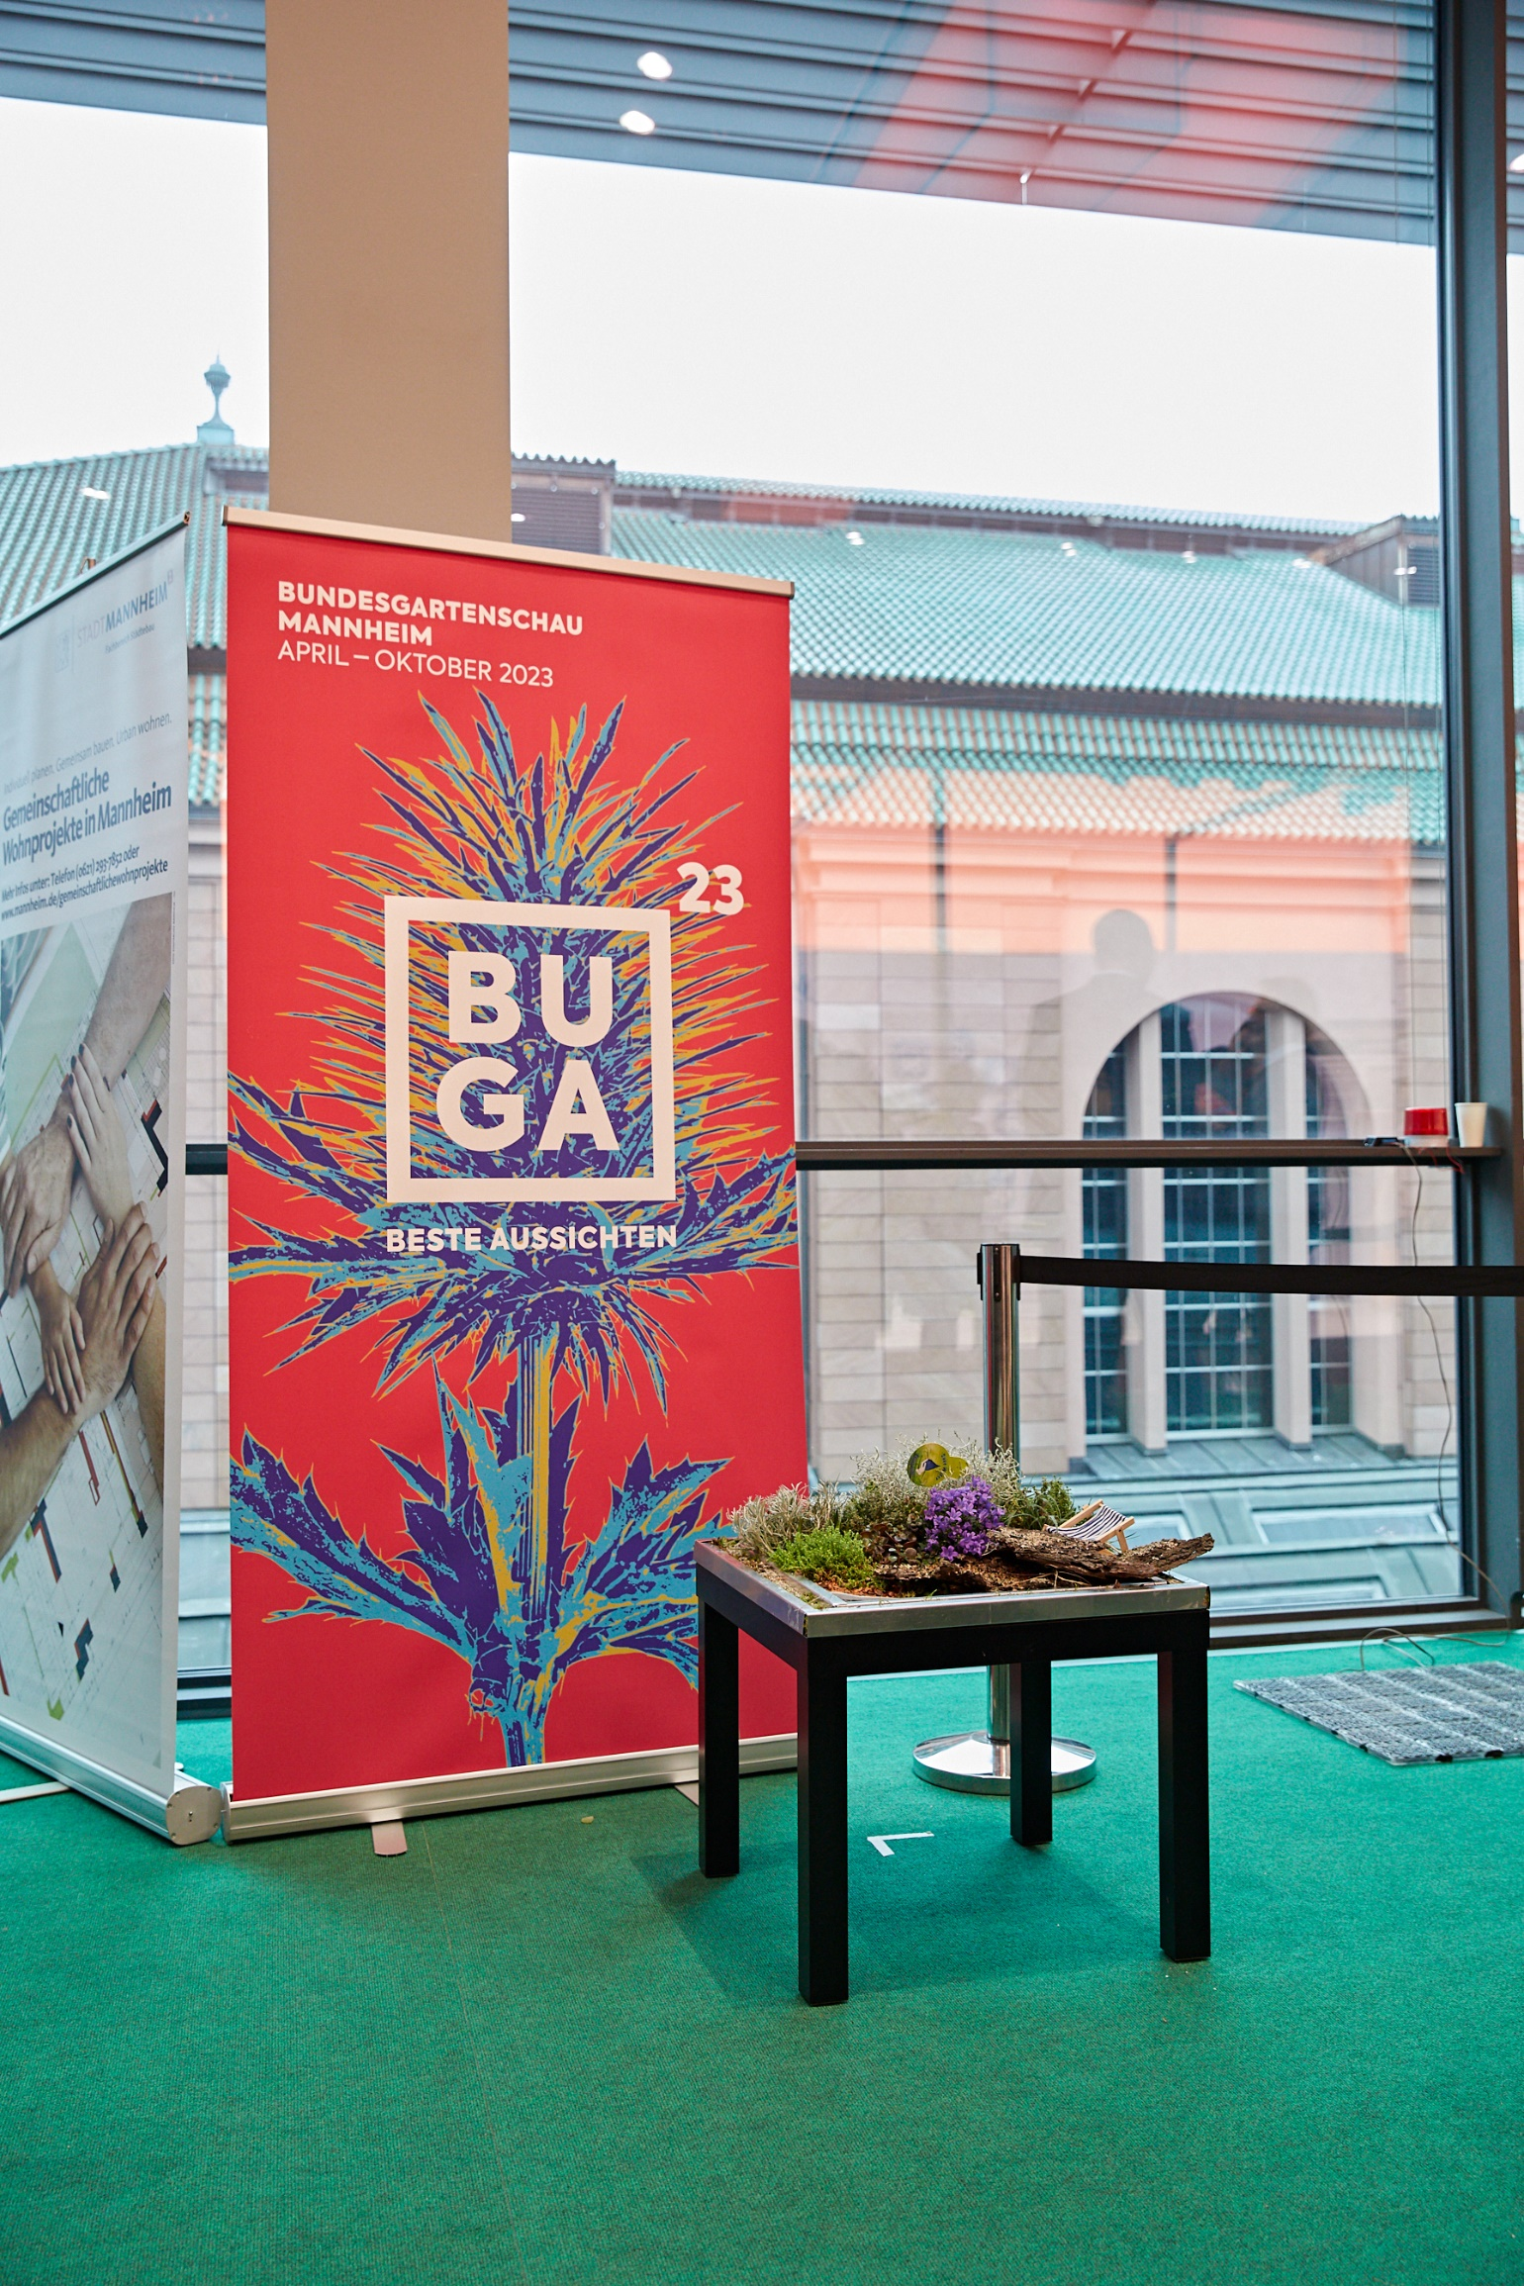
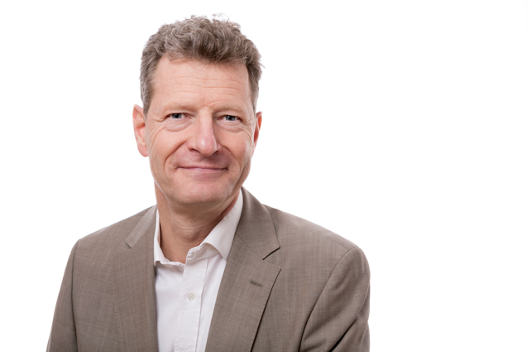
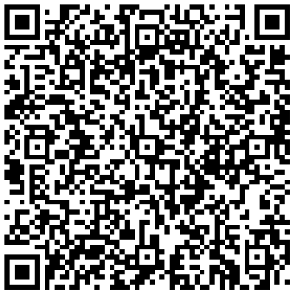
CONTACT
Donald Müller-Judex
Founder and CEO
dmj@solmove.com
+49 172 8656565

Slide 10
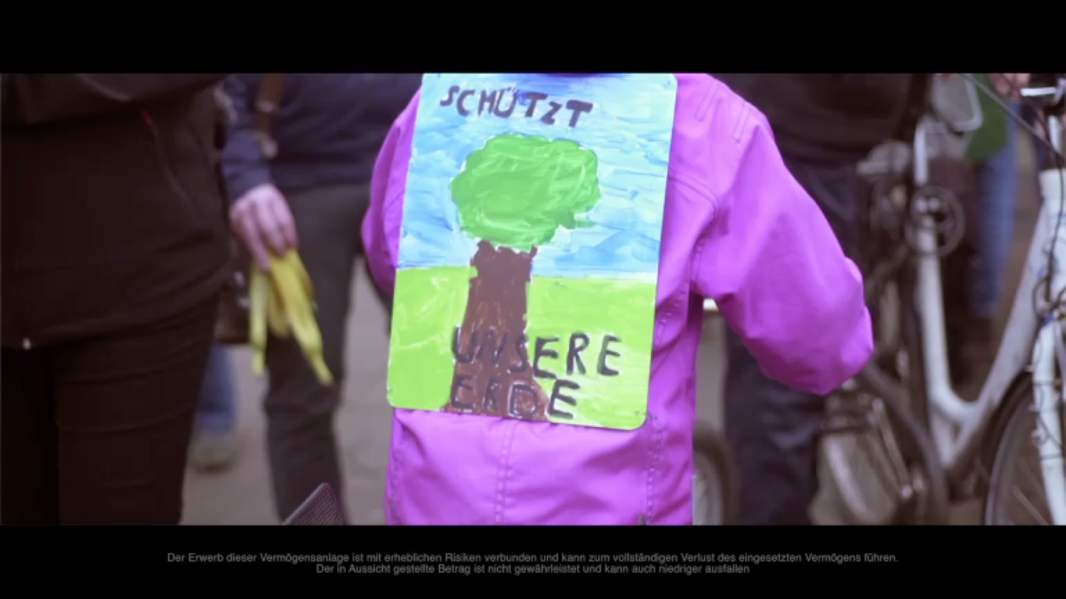
Film
CHALLENGE
Press to open the link
Notes:
10

Slide 11
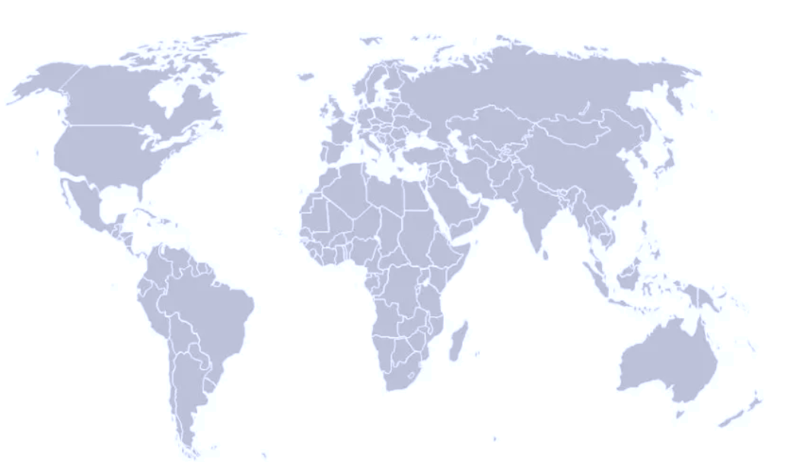

WORLDWIDE REQUESTS
North-America
USA
Hawaii
Las Vegas
South-America
Chile - Santiago
Europe
Germany
Berlin - EUREF Campus
Berlin - Vattenfall
Berlin - Gleisdreieckpark
Berlin - Deutsche Bahn
Berlin - Mercedes
Munich – BMW
Munich - City
Munich - County
Switzerland
Zofingen
Bern
Wädenswil
Asia & Middle East
China - Quigdao Jingjin
UAE - Dubai - German pavilion Expo 2021
Saudi Arabia - Riad – Formel E (Idea)
Japan – Shinoda Construction Co

